Slide 1
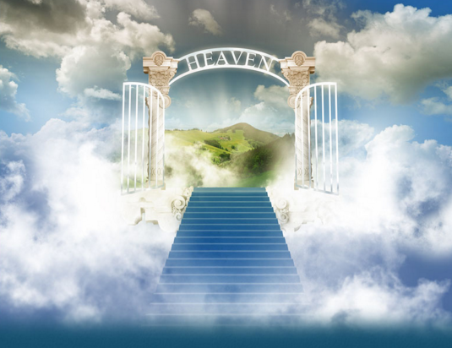
Live Under Open Heavens
Ludwig Easton
27/01/2018

Slide 2
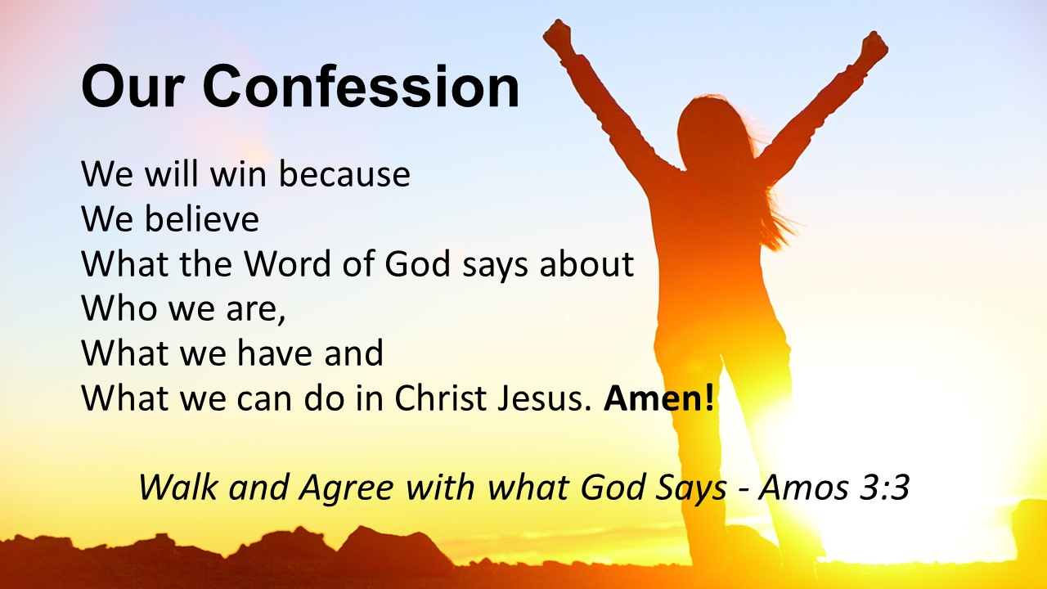
What does God say about us?

Slide 3
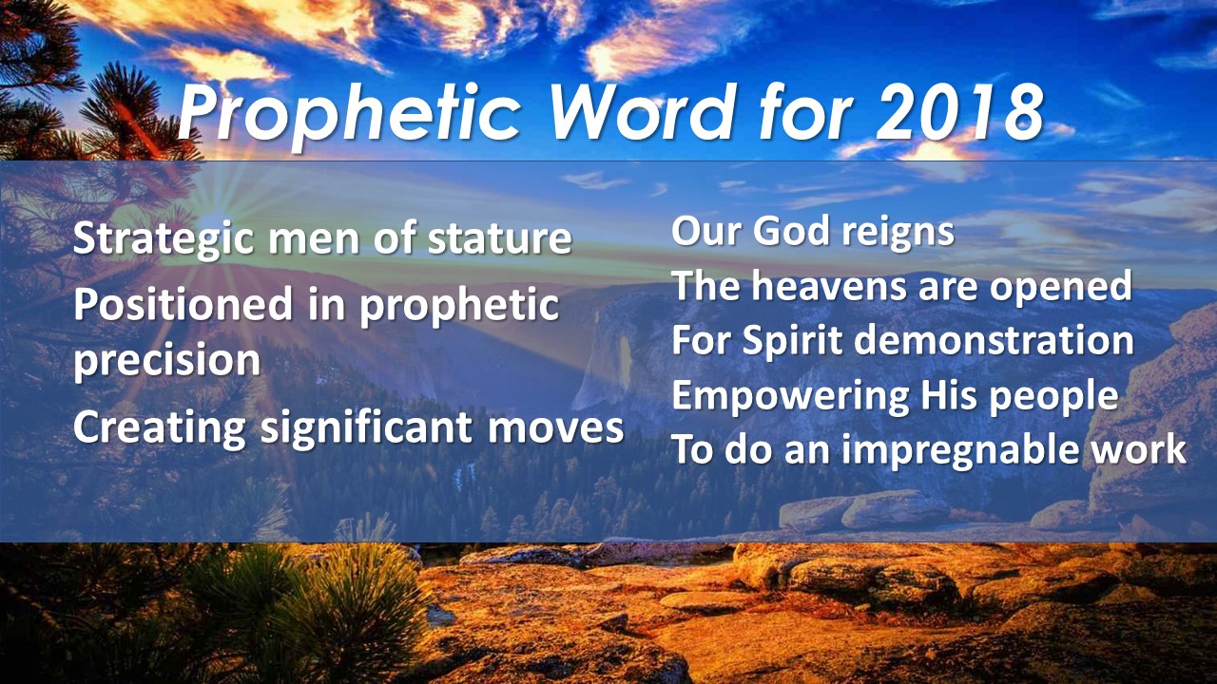
What does God say about us?

Slide 4
Ephesians 1:10
¹⁰ that in the dispensation of the fullness of the times He might gather together
in one all things in Christ; both which are
In heaven and which are
on earth—in Him.

Slide 5
Deuteronomy 11:21 (NKJV)
²¹ that your days and the days of your children may be multiplied in the land of which the Lord swore to your fathers to give them; like the days of the heavens above the earth.

Slide 6
Deuteronomy 11:21 (KJV)
²¹ That your days may be multiplied; and the days of your children; in the land which the Lord sware unto your fathers to give them; as the days of heaven upon the earth.

Slide 7

Luke 11:52-54 (Scribes can’t enter and prevent others to enter in)
Matthew 5:20 (Pharisee can’t enter)
Heb 4:6-12

Slide 8
I will serve God’s Purpose
I will hear and heed the Proceeding Word
I will know God’s Peace
I will walk in God’s Progress
I will receive God’s Provision & Prosperity
I will experience God’s Outpouring of Power
I will have Power to Prevail
I will draw God’s Presence

Slide 9
How To Live Under Open Heavens (In Christ)
Be conscious of God’s Presence
Hear & Heed the Father’s voice
Please the Father by Faith
Obey & Submit to God’s Now(Proceeding) Word
Tithe and Give unto the Lord and local church
Unite ourselves as One Man
Pray with all kinds of prayer
Speak and Proclaim God’s Word (Become His voice and not a noise).
Worship at the Throne in Spirit and in Truth

Slide 10
How To Live Under Open Heavens
Be Conscious of God’s Presence, Serve God’s Purpose. In God’s Purpose, there is Protection(Gen 28; John 1:14; Ps 91).
Hear & Heed the Father’s voice, hear the Proceeding Word (Is 6:1-13; Rev 4; Ezekiel 1:1-3. 28; Matthew 3: 13-17; Luke 3:21-22; Mark 1:9-11; Ps 78:23-25)
Please the Father, know God’s Peace (Matt 3:16; Mark 1:10; Heb 11:6; 4:1-13)
Obey & Submit the NOW Word (Christ) and walk in God’s Progress (Matthew 3: 13-17; Luke 3:21-22; Mark 1:9-11; Ps 119:60; Luke 9:56-62)
Tithing & Giving to the local church (Storehouse); releases God’s Provision & Prosperity (Malachi 3:8-10)

Slide 11
How To Live Under Open Heavens
When we Unite ourselves as one Man, we will Experience God’s Power from on High (Acts 2:1-4; Eph 4:11-16)
Pray with all kinds of prayer that has the power to Prevail (Luke 3:21-22; Luke 11:2-4; Matthew 16:13-16; 6:9-13; Eph 1:17-21; 6:17-20; 3:14-20; Phil 4:6-7; 1 Sam 2; 1 Cor 14, Ps. 127; Ps 141)
Speak & Proclaim God’s Word will create Pathways in the Spirit (Acts 2:14; 40-43; John 1:19-23; Amos 3:7; Ez 37; Heb 12:25-26; 2:2-3; Mark 1:2-3, Micha 4, Is 2:2)
Worship at the throne draws God’s Presence (Gen 12:6-8; Ez 1; Rev 4 & 5; John 4:23-24; 2 Chron 20:15-25)

Slide 12
1. Be Conscious of God’s Presence; and we will serve God’s Purpose
Don’t miss Him when we come to church
The Jews missed Him (John 1) – We can’t receive from Him if we don’t recognise Him (Honour)
We are God’s House and temple
When we are conscious of Him; we don’t have to be intimidated by the enemy

Slide 13

2. Hear &Heed the Father’s voice, hear the Proceeding Word
Uzziah must die
As long as Uzziah is alive; we can’t see
Perception is not accurate
God speaks
Through the angel (Messenger/Man of God) of the Church
Local Church - To the angel of the Church of … (Rev 2-3)
Body of Christ - He who has an ear, let him hear what the Spirit says to the churches (Rev 2-3)
To Individuals

Slide 14
3. Please the Father, know God’s Peace
Jesus please the Father
Without Faith, it is impossible to please God (Heb 11:6)
Hear, mix it with faith, enter into His rest (Heb 4: 1-13)
Romans 10, Hear, faith and speak

Slide 15
4. Obey the Word (Christ) and Experience God’s Progress
Jesus fulfilled all righteousness
Obedience is the key in Deut 11
Ps 119:60; Luke 9:56-62

Slide 16

5. Tithe & Give to the local church Releases God’s Provision & Prosperity

Slide 17

6. When we Unite ourselves as one Man, we will Experience God’s Power
We will experience our Pentecost
The infilling of the Holy Spirit
The Dimensions of the Spirit
To the measure of the stature of the fullness of Christ (Eph 4:11-16)

Slide 18
7. Prayer that has the power to Prevail
Jesus prayed when he was baptised (Luke 3:21-22; Luke 11:2-4; Matthew 16:13-16)
Matthew 6:9-13
⁹ After this manner therefore pray ye: Our Father which art in heaven; Hallowed be thy name.
¹⁰ Thy kingdom come;
Thy will be done in earth; as it is
in heaven.
¹¹ Give us this day our daily bread.
¹² And forgive us our debts; as we forgive our debtors.
¹³ And lead us not into temptation; but deliver us from evil: For thine is the kingdom; and the power; and the glory; for ever. Amen.

Slide 19
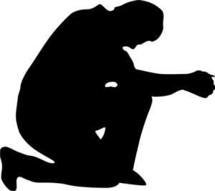
Prayer of Supplication (Eph 6:18-20)
Pray According to God’s Word (Eph 1:17-23; 3:14-21; 6:18-20)
Prayer of Thanksgiving (Phil 4:6-7, Eph 1:15-16, Col 3:16-17)
Praying in tongues (1 Cor 14, Jude 20)
Worship is also a form of prayer
Declaration, Praise & Testifying of who God is (Ps. 141, 1 Sam)
Prophesying (1 Sam 2; Rev 19:10)
Decreeing over our enemies (1 Sam 2:9-10, Ps 141, Ps 127)

Slide 20

8. Proclamation (voice) that creates Pathways in the Spirit
(Acts 2:14; 40-43; John 1)
John 1: 23
He said: “I am (John The Baptist)
‘The voice of one crying in the wilderness:
“Make straight the way of the Lord;”’
We present the pathway when we share the gospel (Gate that leads to life and the other to destruction)
Amos 3:7-8; Micha 4; Is 2
Hebrews 12:25-26
God speaks from heaven (Mt Zion)
Hebrews 2:2-3
Those who heard Him confirmed what God is saying in heaven.
The prophetic is to confirm what God is already speaking.

Slide 21

9. Worship at the throne that draws God’s Presence
Ez 1, is the same scene of what John sees in Revelation. Rev 4 describes it as worship in heaven. Ez 1 says the heavens were opened, Rev 4 says a door standing open in heaven.
Worship is associated with Heavenly activities & God’s Presence(Gen 12:6-8, Is 6, Rev 4)

Slide 22
John 4:21-24
²¹ Jesus said to her; “Woman; believe Me; the hour is coming when you will neither on this mountain; nor in Jerusalem; worship the Father.²² You worship what you do not know; we know what we worship; for salvation is of the Jews. ²³ But the hour is coming; and now is; when the true worshipers will worship the Father in spirit and truth; for the Father is seeking such to worship Him. ²⁴ God is Spirit; and those who worship Him must worship in spirit and truth.”
2 Chronicles 20:17

